Slide 1
3D Platformer
Nepal Engineering College
Mid-Term Defense
Satyam Jha(019-387)
Susant Neupane(019-393)
Sandesh Nilas Khatiwada(019-382)

Slide 2
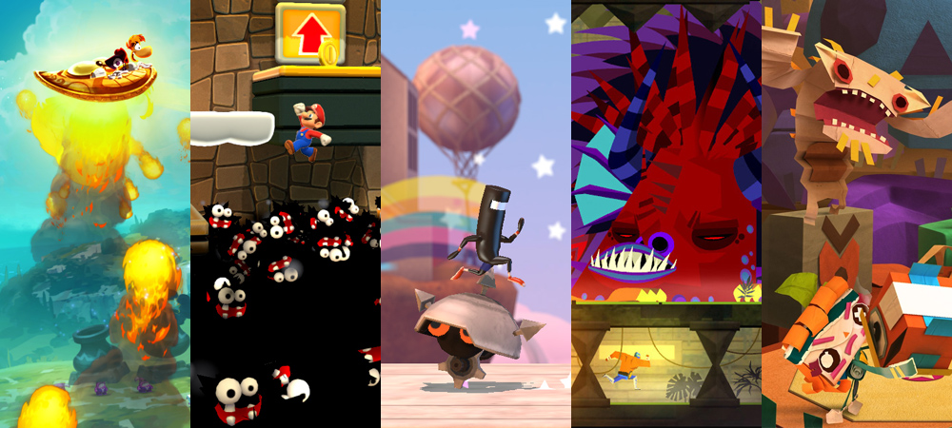
Introduction
Simply a jump and run game.
Inspired by the platformer genre of game like Mario, Adventure Island and so on .
Created as a simple and minimalistic game that helps the player to consume their time.
First person perspective game.

Slide 3

Problem statement
Since it is a 3D – game, It requires more graphics and hardware
And can be addictive.
It will be easily accessible from indie games websites for free of cost.

Slide 4



Objective & Aim
Make game accessible for every user.
Make game low of cost.
Make the game simple and engaging
Help user to think logically
Main aim of the game is to meet all of the above objective and free deployment of the game in the server of popular platform like steam, epic game and so on.

Slide 5
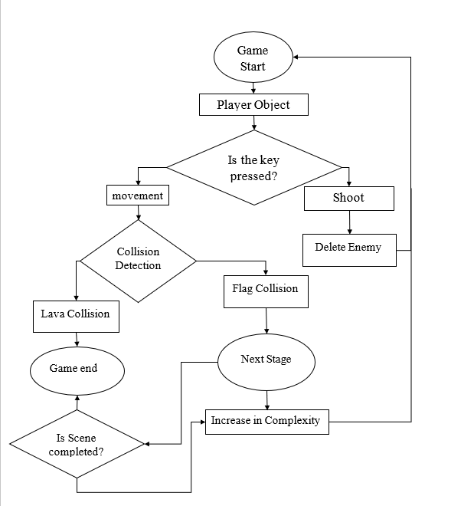
System Design
How the game works?
Game starts
Finds the player object in the starting scene
Is the key pressed? If yes which one ? Shoot or move?
Move then
Does it collide?
Flag or lava
If lava, player dies.
If flag, next stage.
Shoot (Is enemy there)?
If return enemy
Delete enemy and continue and repeat

Slide 6
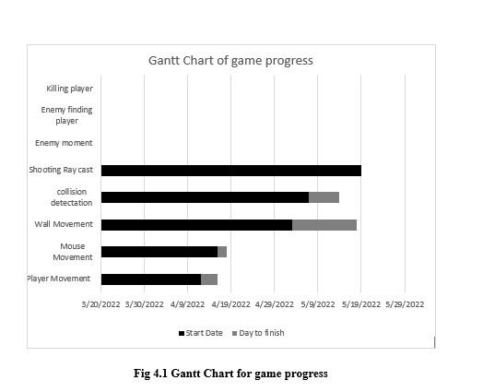
Implementation and Discussion
Implemented module
Player Movement
Wall running
Jumping
Look around
Task to be completed
Design of stage
Give player and enemy shooting mechanism
Make game presentable
Change shooting mechanism

Slide 7

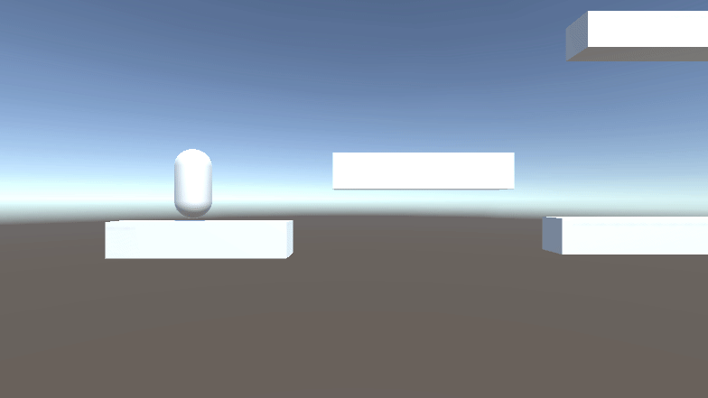
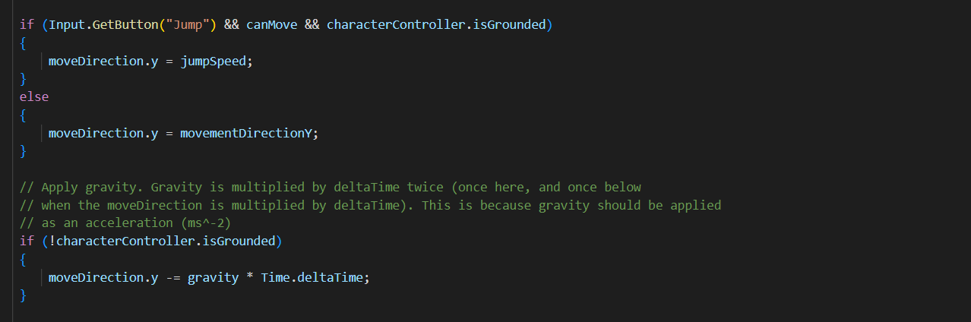
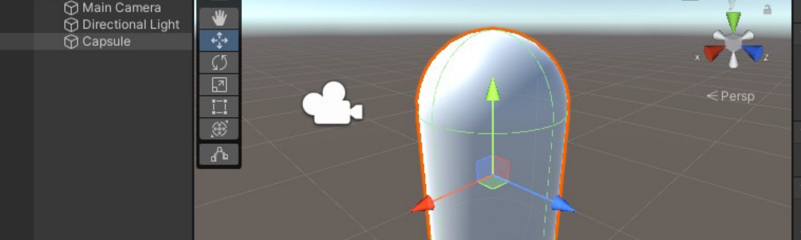
How does player move?
When W,A,S,D keys are pressed, it gets axis and increase the axis.
When the player does not get the ground it disable the jump.

Slide 8
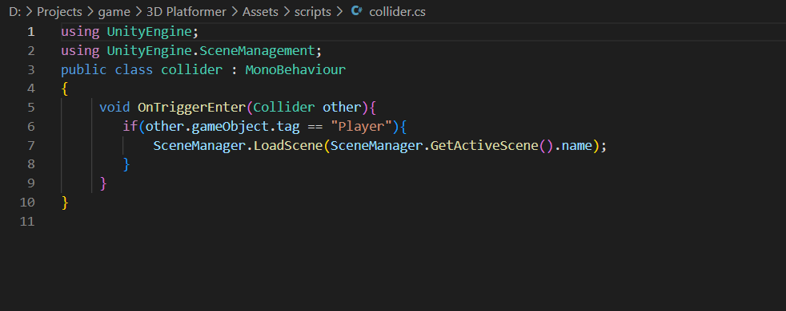
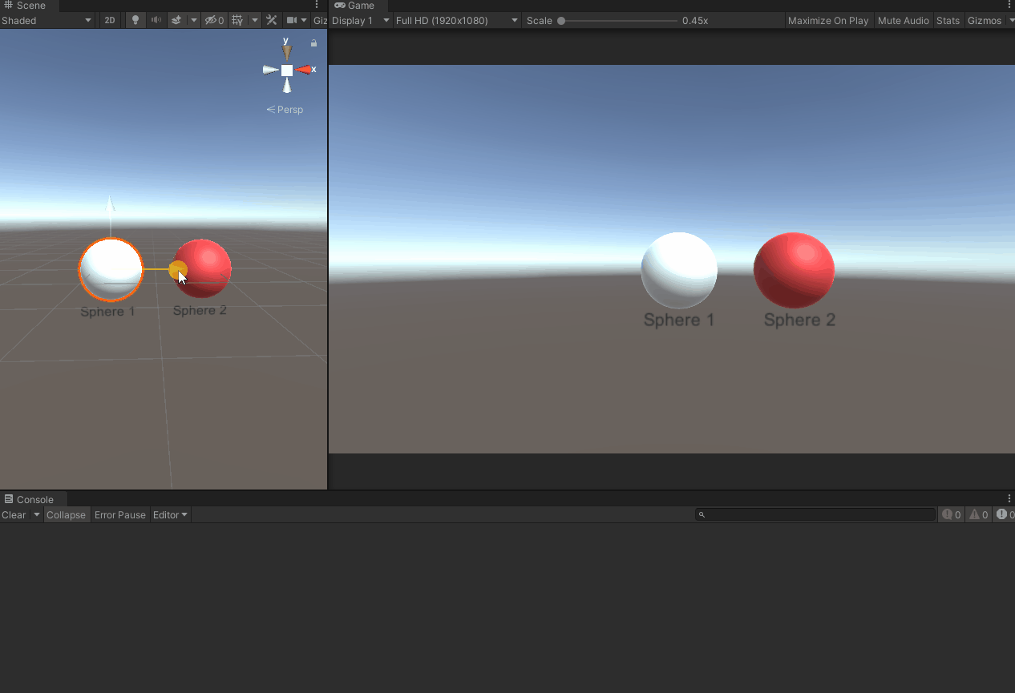
How does collision work?
When the player collide with the object it sends the feedback and if check where it is collided

Slide 9
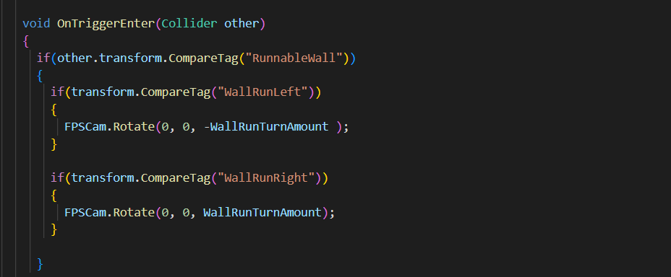
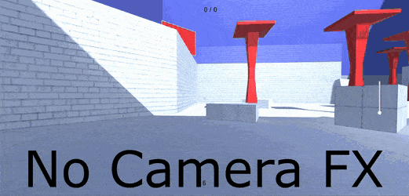
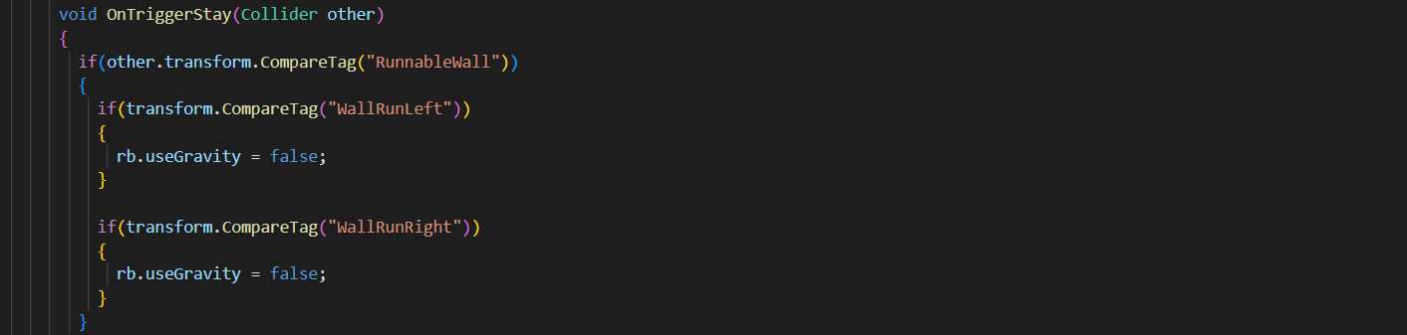
How does wall running work?
It finds the normal angle normal to the wall.
It disable the gravity in the rigid body

Slide 10
Conclusion
By developing this game we, as developers have improved our problem-solving strategy. We have gathered more knowledge about unity3D modelling and C# language by researching. In coming days 3D platformer will surely be the interesting and popular game among the gamers and can be found in different platform like steam, epic game and so on. Also the future developers will get the motivation to develop their own ideas.

Slide 11


